Slide 1
MODULE II

Slide 2
Syllabus of module 2
Classes fundamentals
Objects
Methods
Constructors
Parameter passing
Overloading
Access control keywords.

Slide 3
Creating and Using Classes in Java
Syntax of Class :
class classname
{
type instance-variable1;
type instance-variable2;
// ...
type instance-variableN;
type methodname1(parameter-list)
{ // body of method }
type methodname2(parameter-list)
{ // body of method }
// ...
type methodnameN(parameter-list)
{ // body of method }
}

Slide 4
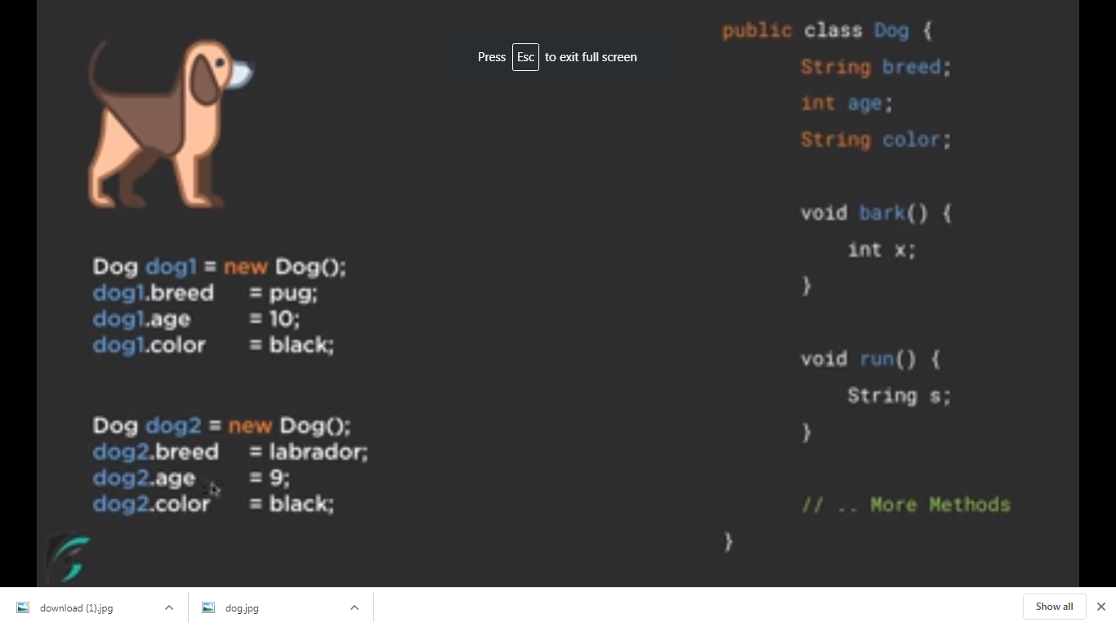

Slide 5
Class defines a new data type.
Once defined, it can be used to create objects of that type.
A class is a template for an object, and an object is an instance of a class.
The methods and variables defined within a class are called members of the class.
The variables, defined within a class are called instance variables. The data for one object is separate and unique from the data for another.
Methods determine how class data can be used.

Slide 6
Example:
Define a class Box which defines three instance variables: width, height, and depth.
class Box
{
double width;
double height;
double depth;
}
This class defines a new data type called Box

Slide 7
Declaring a class Object
An object is an instance of a class.
Declaration of an object is a two-step process :
  Declare a variable of the class type.
  Acquire an actual, physical copy of the object and assign it to that variable. This can be done using the new operator.
The new operator dynamically allocates memory for an object and returns a reference to it. This reference is the address in memory of the object allocated by new. This reference is then stored in the variable.
Example :
Box mybox; // declare reference to object
mybox = new Box(); // allocate a Box object
The above statements can also be written as follows
Box mybox = new Box();

Slide 8
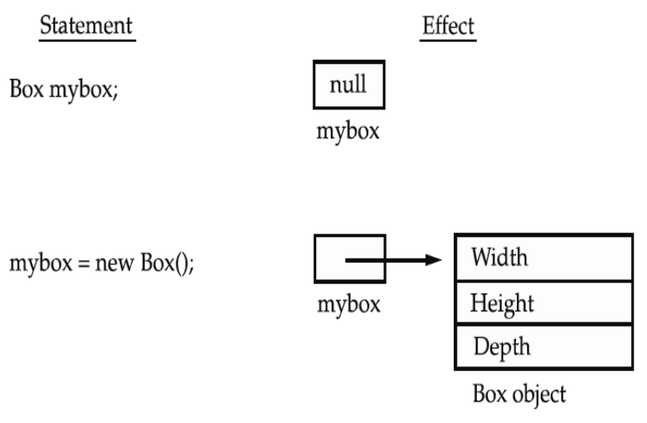

Slide 9
To access the variables dot (.) operator is used.
Example : assign the width variable of mybox the value 100
mybox.width = 100;
If we have two Box objects, each has its own copy of depth, width, and height. Changes to the instance variables of one object have no effect on the instance variables of another.
Write a program to find the volume of a box, whose dimensions are given

Slide 10
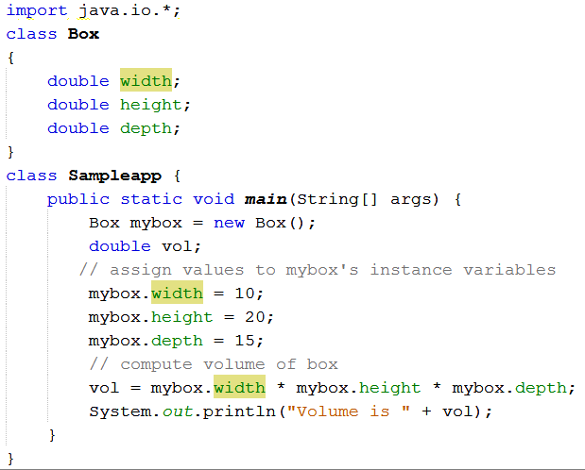

Slide 11
import java.io.*; OR
class Box
{
double width;
double height;
double depth;
public static void main(String args[])
{
Box mybox=new Box();
double vol;
mybox.width=10;
mybox.height=20;
mybox.depth=15;
vol=mybox.width*mybox.height*mybox.depth;
System.out.println("Vol is "+vol);
}
}

Slide 12
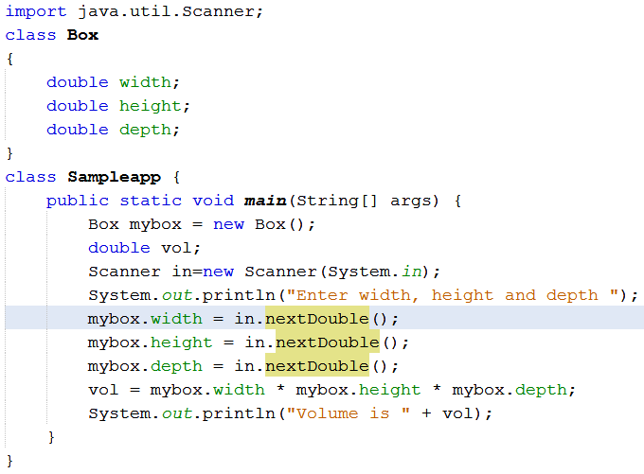

Slide 13
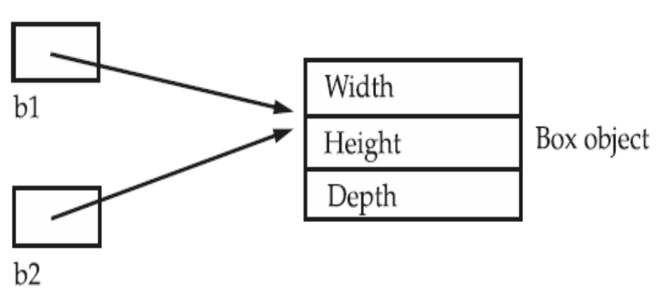
Assigning Object Reference Variables
Example:
Box b1 = new Box();
Box b2 = b1;
A subsequent assignment to b1 will simply unhook b1 from the original object without affecting the object or affecting b2.
Example: Box b1 = new Box();
Box b2 = b1;
// ...
b1 = null;
Here, b1 has been set to null, but b2 still points to the original object.

Slide 14
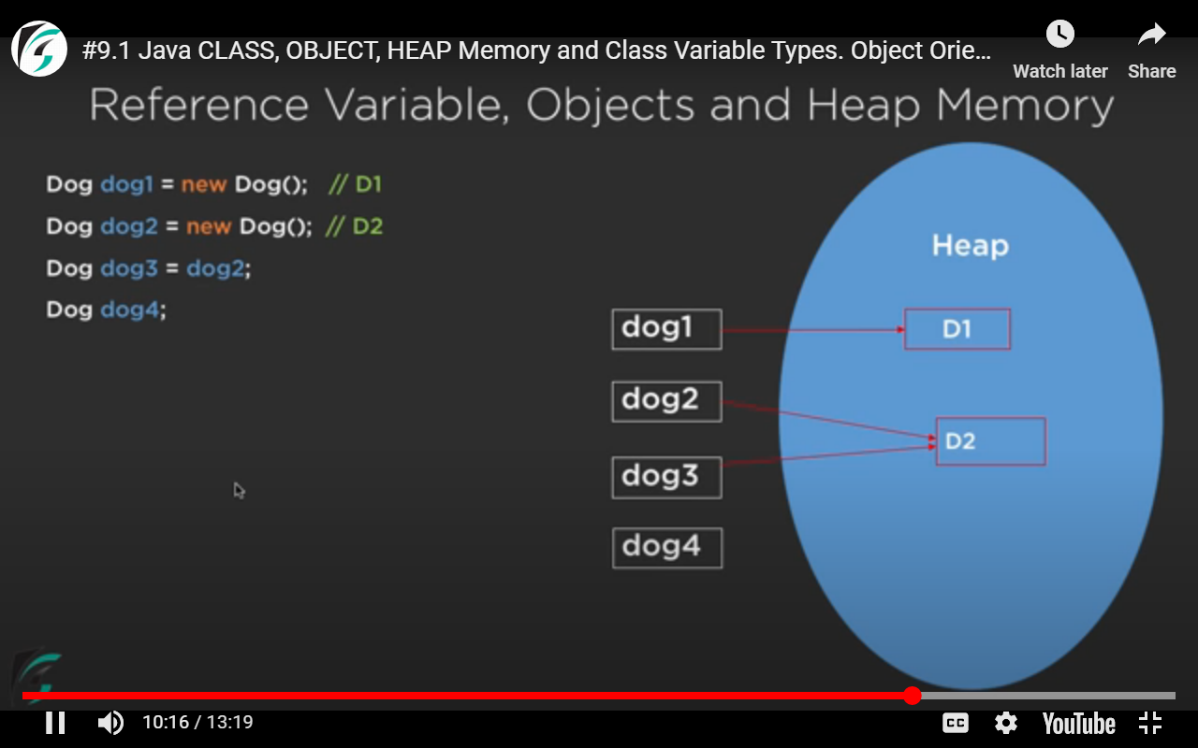

Slide 15
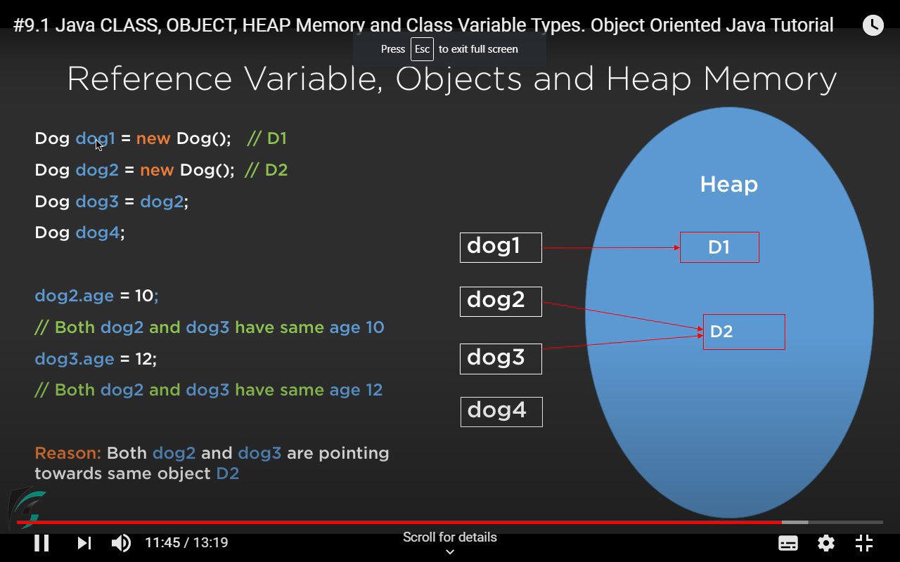

Slide 16
class Sampleapp {
public static void main(String[] args) {
Box mybox = new Box();
Box b2=mybox;
System.out.println("Enter width, height and depth ");
mybox.width = 2;
mybox.height =2;
mybox.depth = 3;
b2.width=12;
System.out.println("Width of box mybox : "+mybox.width);
System.out.println(“Depth of box mybox : "+b2.depth);
}
//output
Width of box mybox :12
Depth of box mybox : 3
}

Slide 17
Methods
Syntax : type name(parameter-list)
{
// body of method
}
Methods that have a return type other than void return a value to the calling routine
  Syntax :
  return value;
  The type of data returned by a method must be compatible with the return type specified by the method.
  The variable receiving the value returned by a method must also be compatible with the return type specified for the method.
The name of the method should be a legal identifier.

Slide 18
Q1)Write a program to find the volume of a box using method.
Q2)Write a program to find the volume of a box (whose dimensions are given) using method with a return type.
Q3)Write a program to find the volume of a box(whose dimensions are given) using parameterized method.

Slide 19
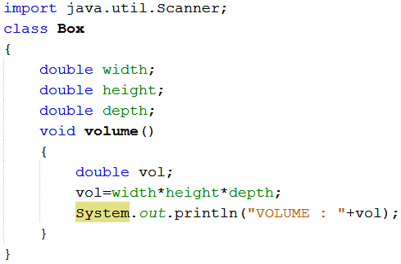
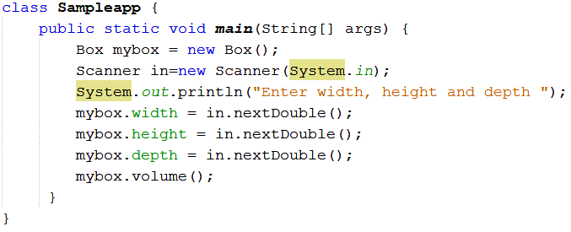

Slide 20
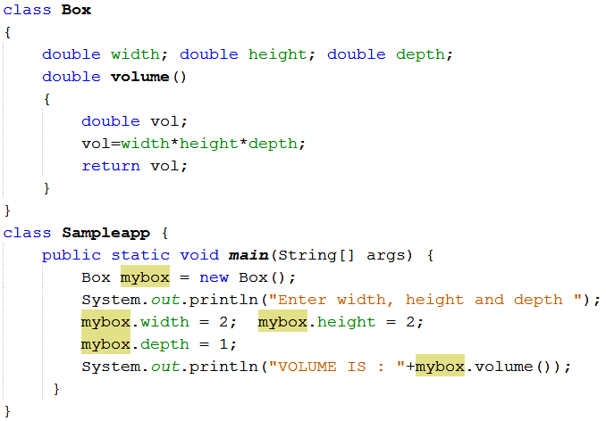
Q2

Slide 21
import java.io.*; OR
import java.util.Scanner;
class Box
{
double width;
double height;
double depth;
double volume()
{
double vol ;
vol =width*height*depth;
return vol;
}
}
class Sampleapp{
public static void main(String[] args) {
Box mybox = new Box();
Scanner in =new Scanner(System.in);
double d;
System.out.println("Enter width, height and depth ");
mybox.width = in.nextDouble(); mybox.height =in.nextDouble();mybox.depth = in.nextDouble();
d=mybox.volume();
System.out.println("Vol is "+d);
}
}

Slide 22
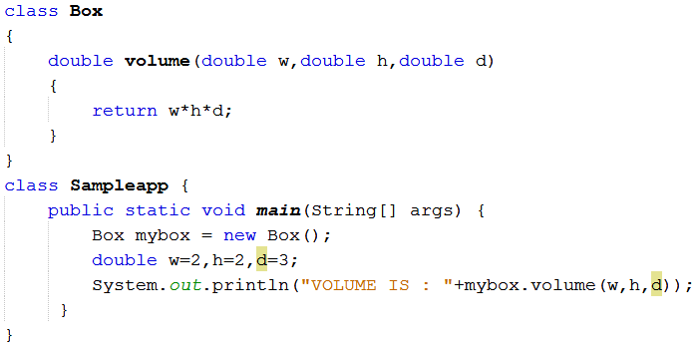
Q3

Slide 23
import java.util.Scanner; OR
class Box
{
double volume(double w,double h,double d)
{
return w*h*d;
}
}
class Sampleapp
{
public static void main(String args[])
{
Box mybox=new Box();
Scanner in =new Scanner(System.in);
System.out.println("Volume is "+mybox.volume(in.nextDouble(),in.nextDouble(),in.nextDouble()));
}
}

Slide 24
TUTORIAL 3
1. Create a class circle with data field radius. Calculate the area and perimeter using methods with return type.
2. Create a class student with fields rollno, name and marks of three subjects. Calculate the total marks and percentage obtained by the student.

Slide 25
Argument/Parameter Passing
Two ways to pass an argument to a method :
  call-by-value (or pass by value)
  call-by-reference (or pass by reference)
Call by value : If we call a method by passing a value, it is known as call by value. The changes being done in the called method, is not affected in the calling method.
Call by Reference: Here original value is changed if changes are made in the called method. If we pass object in place of any primitive value, original value will be changed.

Slide 26
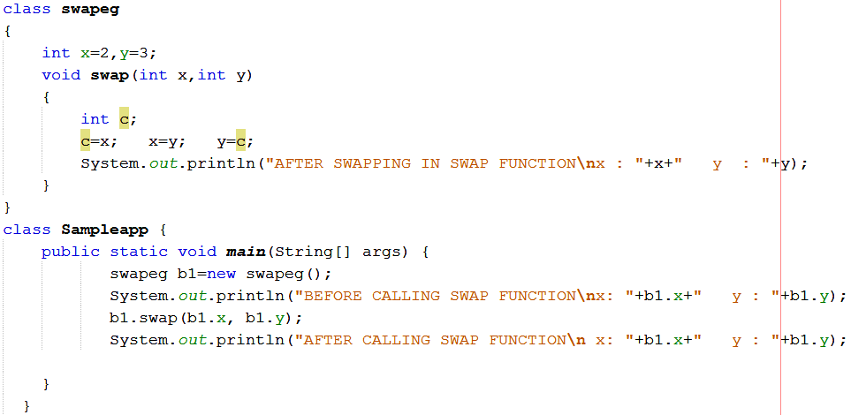
Example for Pass by value

Slide 27

Output:

Slide 28
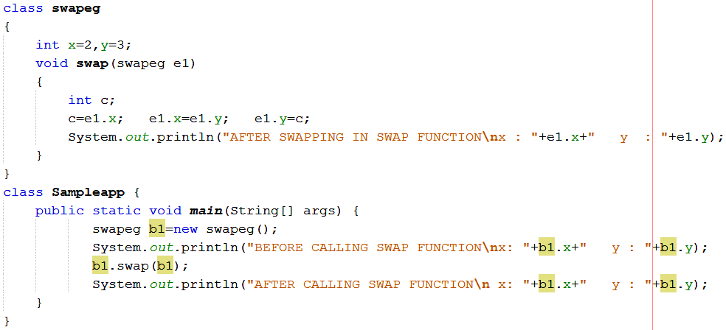
Example for Call By Reference (here object is passed as parameter)

Slide 29

Output

Slide 30
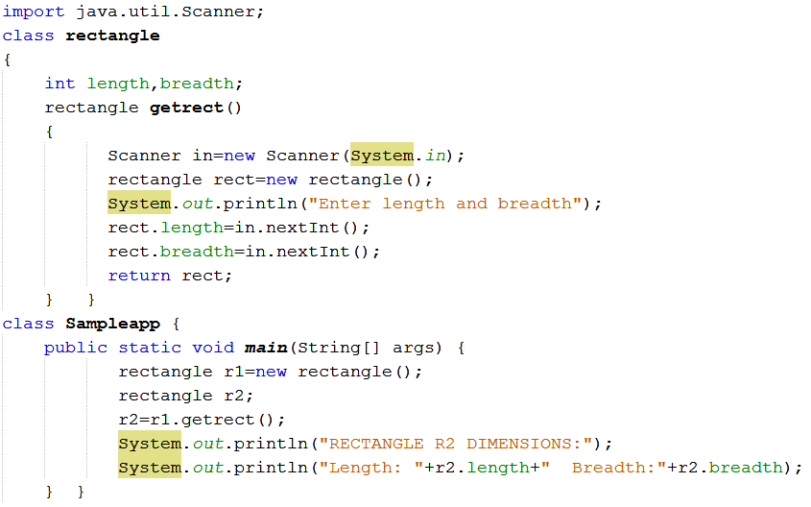
Returning Objects in Methods

Slide 31
Constructors
Used to initialize objects when they are created.
It has the same name as the class in which it resides.
It is syntactically similar to a method.
The constructor is automatically called immediately after the object is created.
Constructors have no return type.
Parameterized Constructor : A constructor having parameter is called parameterized constructor.

Slide 32
Q1. Write a program to find the volume of a box using constructor
Q2. Write a program to find the volume of a box using parameterized constructor

Slide 33
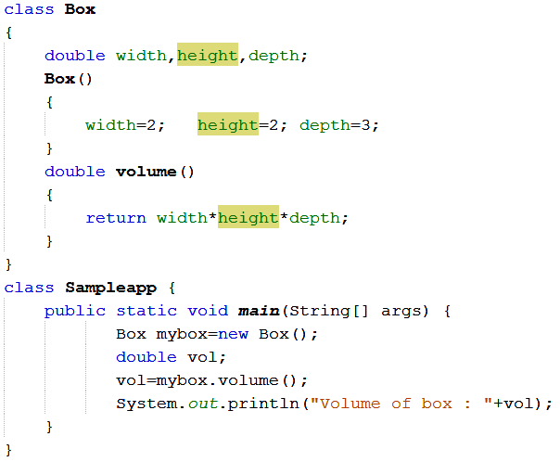
Q1

Slide 34
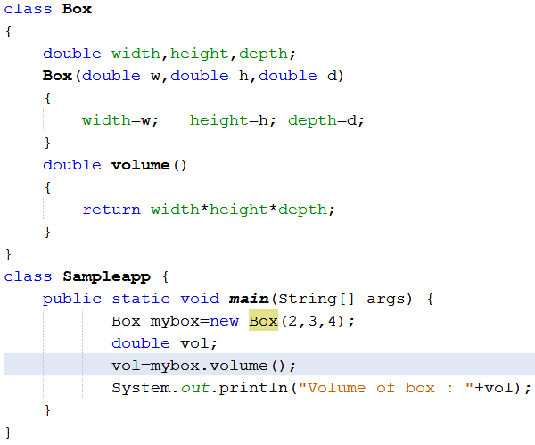
Q2

Slide 35
this Keyword
this keyword can be used inside any method to refer to the current object.
Example :
  Box(double w, double h, double d)
  {
  this.width = w;
  this.height = h;
  this.depth = d;
  }
  Here the use of this is redundant
this can be used to resolve any name space collisions that might occur between instance variables and local variables.
  Box(double width, double height, double depth)
  {
  this.width = width;
  this.height = height;
  this.depth = depth;
  }

Slide 36
Overloading
Overloading refers to the ability of a class to have multiple constructors or multiple methods with the same name but with different number or type of arguments list.
Overloading is a way by which java implements polymorphism.
There are two types :
  Method Overloading
  Constructor loading

Slide 37
Method Overloading
In Java it is possible to define two or more methods within the same class that share the same name, as long as their parameter declarations are different. This is called method overloading.
When an overloaded method is invoked, Java uses the type and/or number of arguments as its guide to determine which version of the overloaded method to actually call.
While overloaded methods may have different return types, the return type alone is insufficient to distinguish two versions of a method.
Q)Write a program to display an character, integer number and a floating point number using the concept of method overloading

Slide 38
Constructor Overloading
Constructor methods can also be overloaded
class Box { double width, height,depth; Box(double w, double h, double d) { width = w; height = h; depth = d; } Box() { width = -1; height = -1; depth = -1; } Box(double len) { width = height = depth = len; } double volume() { return width * height * depth; } }
class OverloadCons { public static void main(String args[]) { Box mybox1 = new Box(10, 20, 15); Box mybox2 = new Box(); Box mycube = new Box(7); double vol; vol = mybox1.volume(); System.out.println("Volume of mybox1 is " + vol); vol = mybox2.volume(); System.out.println("Volume of mybox2 is " + vol); vol = mycube.volume(); System.out.println("Volume of mycube is " + vol); } }

Slide 39
Access Control
Access specifiers in Java are :
  Public : This member can be accessed by any other code
  Private : This member can only be accessed by other members of its class.
  Protected : protected applies only when inheritance is involved.
When no access specifier is used, then by default the member of a class is public within its own package, but cannot be accessed outside of its package.

Slide 40
class Test { int a; public int b; private int c; void setc(int i) { c = i; } int getc() { return c; } }
class AccessTest { public static void main(String args[]) { Test ob = new Test(); // These are OK, a and b may be accessed directly ob.a = 10; ob.b = 20; // This is not OK and will cause an error // ob.c = 100; // Error! // You must access c through its methods ob.setc(100); // OK System.out.println("a, b, and c: " + ob.a + " " + ob.b + " " + ob.getc()); } }

Slide 41
Tutorial 4
1. Write a java program to design a class to represent a bank account. Include the following members:
Data members: name of depositor, Account number, Type of Account, Balance amount in account.
Methods : To assign initial values(use constructor), To deposit an amount, To withdraw an amount after checking balance, To display the name and balance.
2. Is there error in the following code. If yes then correct it.
public class Figure
{
public String draw(String s){
return “figure drawn”; }
public void draw(String s){}
public void draw(double f){}
}

Slide 42
static keyword
When a member is declared static, it can be accessed before any objects of its class are created, and without reference to any object.
Example : main( )
Both methods and variables can be declared as static.
Example : static int i;
static void add(){ ……. }
Instance variables declared as static are, essentially, global variables.
When objects of its class are declared, no copy of a static variable is made. Instead, all instances of the class share the same static variable

Slide 43
Properties of static Methods :
  They can only call other static methods.
  They must only access static data.
  They cannot refer to this or super in any way.
Syntax for calling static methods and variables from outside of the class is : classname.method( ); //access static methods
classname.var_name ; //access static variables
Static block : It is defined inside a class to initialize static variables, which gets executed exactly once, when the class is first loaded.
Syntax : static
{…………
}

Slide 44
class StaticDemo { static int a = 42; static int b ; static { b=a*2; } static void callme() { System.out.println("a = " + a); } } class StaticByName { public static void main(String args[]) { StaticDemo.callme(); System.out.println("b = " + StaticDemo.b); } }

Slide 45
final Variables
Final variables prevents its contents from further modification.
Must initialize a final variable when it is declared.
Example:
  final int a = 1;
  final int b = 2;
These values can not be changed during execution.

